Slide 1


BITCOIN FORECAST:
Predicting
Price Trends
Notes:
"Good morning, everyone. Welcome to our presentation on 'Bitcoin Forecast: Predicting Price Trends.' I’m Ayush Prajapati. Today we’ll be discussing our journey in developing a machine learning model for Bitcoin price prediction."

Slide 2


TEAM MEMBERS
Bikram Chand
ML Developer
Ayush Prajapati
Data Analyst & Documentation
Notes:
Before we dive into the details, let me introduce our team. We have Bikram Chand, an expert ML Developer, and me Ayush Prajapati, Data Analyst and Documentation specialist. Together, we've combined our expertise to tackle this challenging and exciting project."

Slide 3
OBJECTIVE
The primary objective is to develop and validate a robust machine learning model capable of accurately forecasting future price trends of Bitcoin. This endeavor aims to leverage historical data encompassing Bitcoin prices, market sentiment, and relevant financial indicators to predict short-term and long-term price movements. The model will serve as a critical tool for investors, financial analysts, and cryptocurrency enthusiasts, providing them with actionable insights to make informed investment decisions.
Notes:
Our objective is clear: Develop a robust model capable of accurately forecasting Bitcoin's future price trends. This tool is designed to serve investors and analysts by providing insights based on historical data, market sentiment, and financial indicators

Slide 4
DATASET
Dataset consists of 26M records of bitcoin currency data.
Fields | Input
BTC-2017min.csv | 1 minute historical data of year 2017
BTC-2018min.csv | 1 minute historical data of year 2018
BTC-2019min.csv | 1 minute historical data of year 2019
BTC-2020min.csv | 1 minute historical data of year 2020
BTC-2021min.csv | 1 minute historical data of year 2021
Data Source: https://www.kaggle.com/datasets/prasoonkottarathil/btcinusd?select=BTC-2018min.csv
Notes:
Let's talk about our dataset. We've worked with over 26 million records of Bitcoin data, ranging from 1-minute historical data from 2017 through to 2021. This comprehensive dataset was sourced from Kaggle, ensuring reliability and depth for our analysis.

Slide 5
MODEL SELECTION AND TRAINING
Models
LSTM (Long Short-Term Memory)
GRU (Gated Recurrent Units)
Bidirectional LSTM (Bi-LSTM)
We’ve developed these models using features - index, values.
80% training data & 20% test data
Notes:
We selected three models for our analysis: LSTM, GRU, and Bidirectional LSTM. These models were trained using an 80-20 split on our dataset, focusing on key features to predict price movements.

Slide 6
MODELS
01
02
03
LSTM (LONG SHORT-TERM MEMORY)
GRU (GATED RECURRENT UNITS)
BIDIRECTIONAL LSTM (BI-LSTM)
Since LSTMs are built to retain long-term dependencies in time series data, they are particularly useful in financial markets where historical trends may have an impact on future prices.
GRUs provide similar functionality as LSTMs but with fewer parameters. This makes them computationally more efficient and faster to train without a significant loss in performance, especially when multiple models or large datasets are involved in the forecasting.
Bidirectional LSTMs run inputs in two ways, one from past to future and another from future to past, essentially providing the model with all available information in the data at every point in time.
Notes:
Each model has its strengths. LSTMs are great for retaining long-term dependencies, Bidirectional LSTMs provide a comprehensive view by analyzing data from both past and future perspectives, and GRUs offer a more efficient alternative with fewer parameters.

Slide 7
Data Analysis and visualization

Slide 8
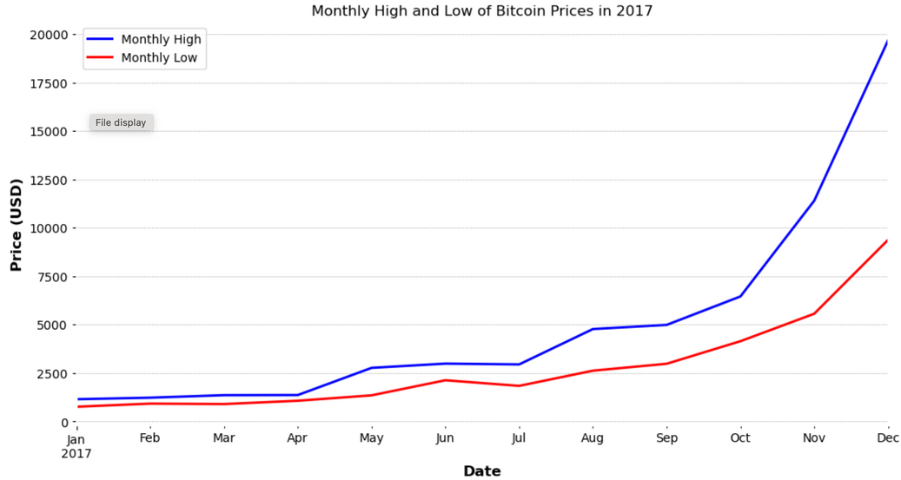
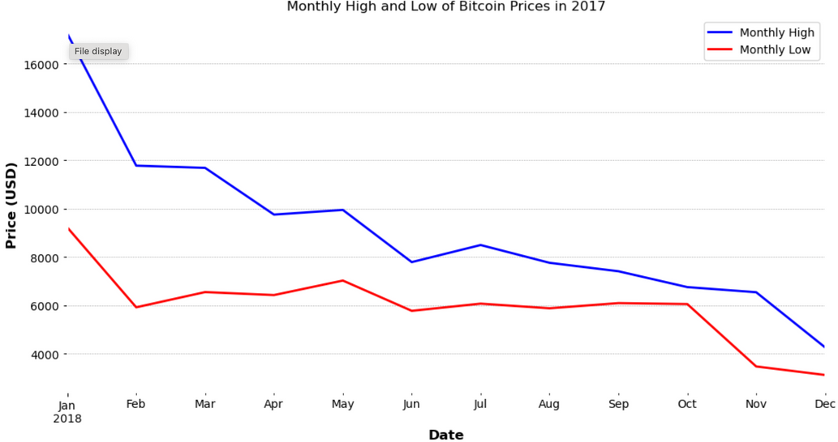
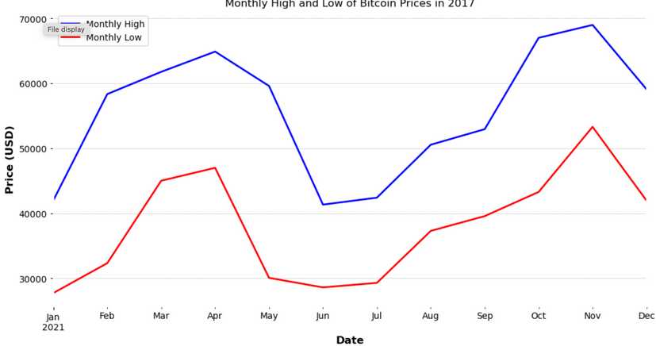
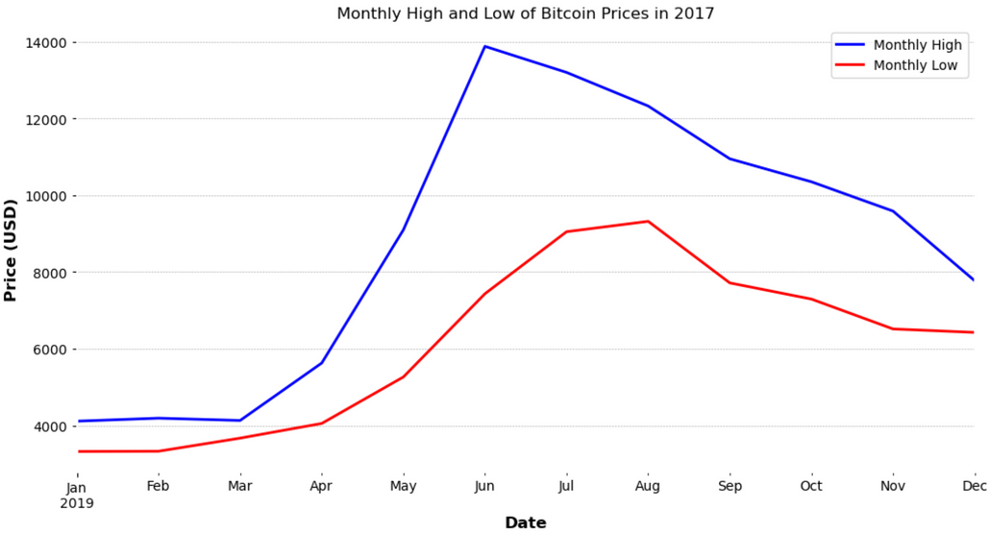
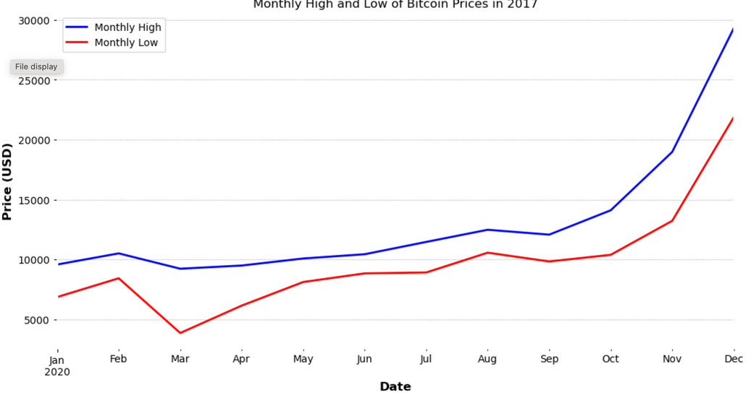
2017
2018
2021
2019
2020
Notes:
Here's a visual representation of Bitcoin's price over the years. Notice the volatility and trends that our models had to consider during training

Slide 9
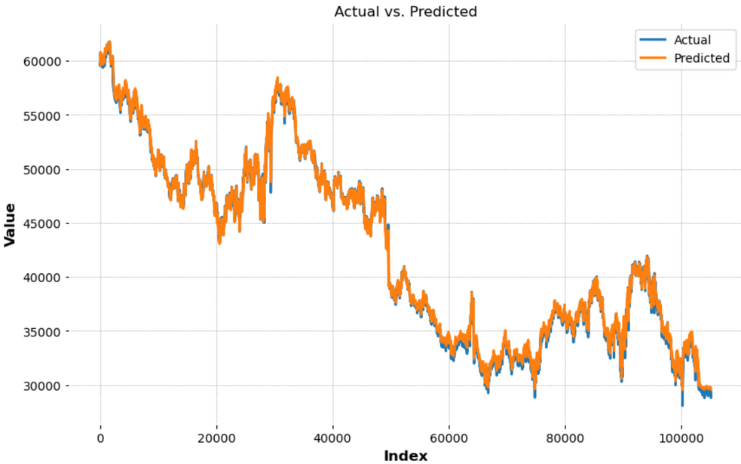
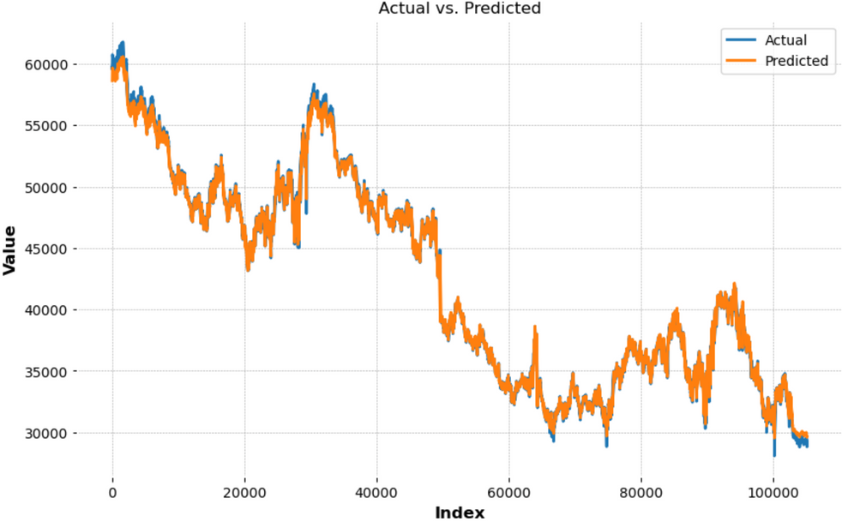
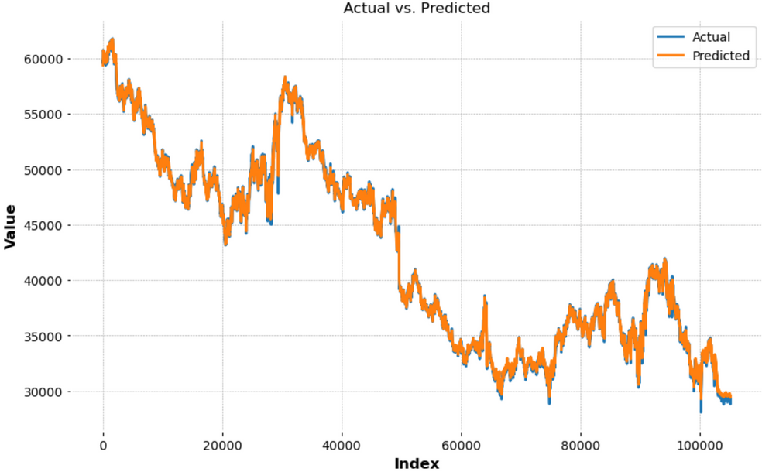
LSTM
GRU
Bidirectional LSTM

Slide 10
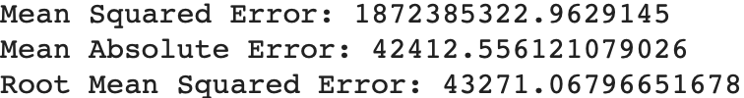
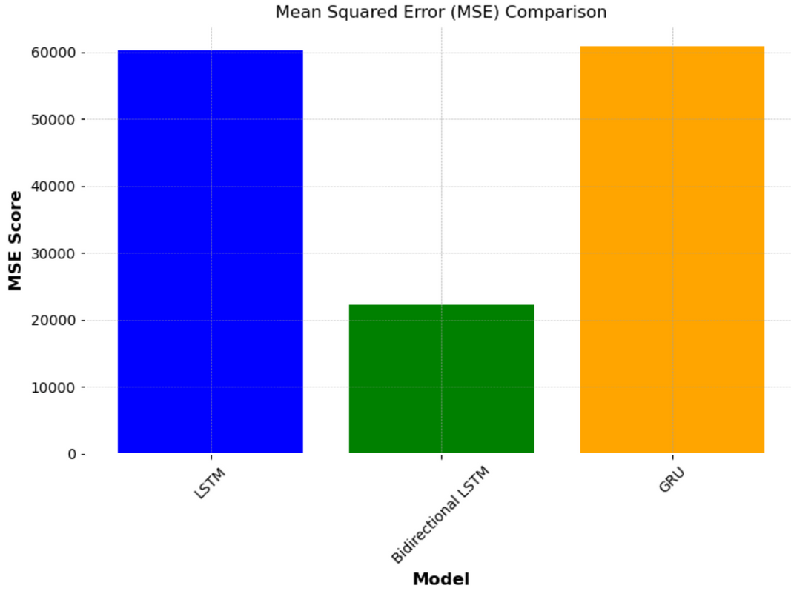
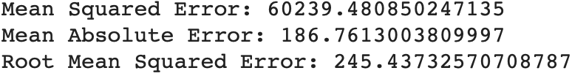
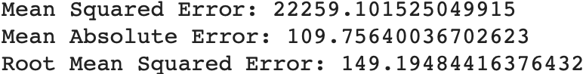
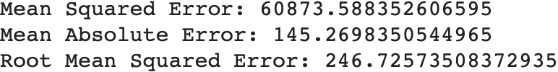
COMPARATIVE ANALYSIS OF MODELS AND RESULTS
LSTM
Without Scaling the Data:
With Scaling the Data:
Bidirectional LSTM
GRU
Notes:
We performed a comparative analysis of the models with and without scaling the data. This helped us understand how each model performs under different conditions

Slide 11
RESULTS AND ACHIEVEMENTS:
In conclusion, Bidirectional LSTM model appears to be the most reliable for forecasting Bitcoin prices with a higher level of accuracy and consistency. It may benefit from further tuning, possibly by incorporating additional data or through ensemble methods that could leverage the strengths of multiple predictive models. Ultimately, the objective would be to continue enhancing the model to ensure robustness and adaptability to the volatile nature of cryptocurrency markets.
Notes:
Our findings concluded that the Bidirectional LSTM model outperformed the others, offering higher accuracy and consistency. We believe further improvements can be made by incorporating additional data or using ensemble methods.
NOW my teammate will takeover and will demonstrate coding section.

Slide 12
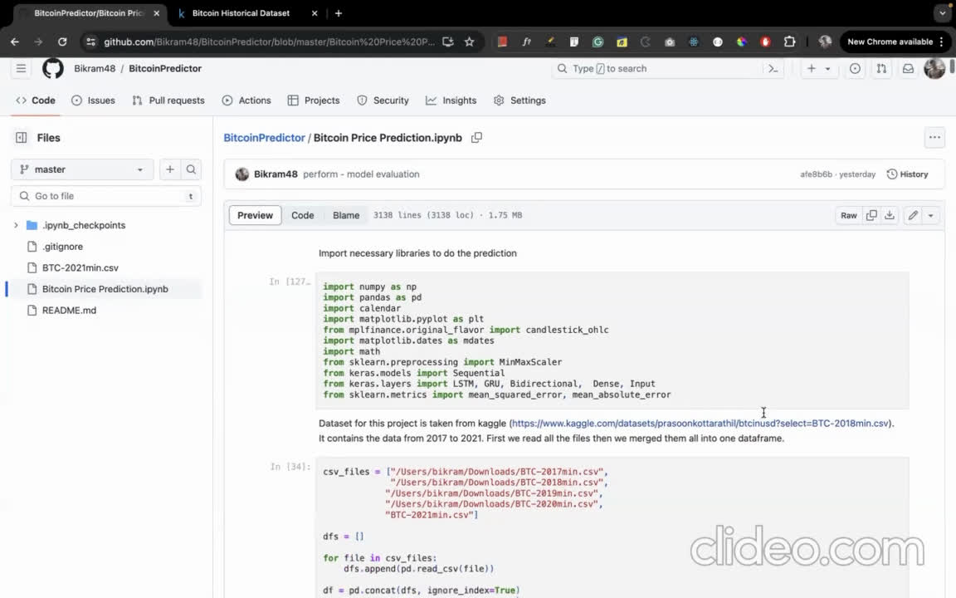
Notes:
NOW my teammate will takeover and will demonstrate coding section.

Slide 13
THANK YOU
Notes:
We'd like to thank you for your attention. We're excited about the potential of our work and look forward to contributing further to the predictive analytics in cryptocurrency markets. We're now open to any questions you may have."

